Slide 1
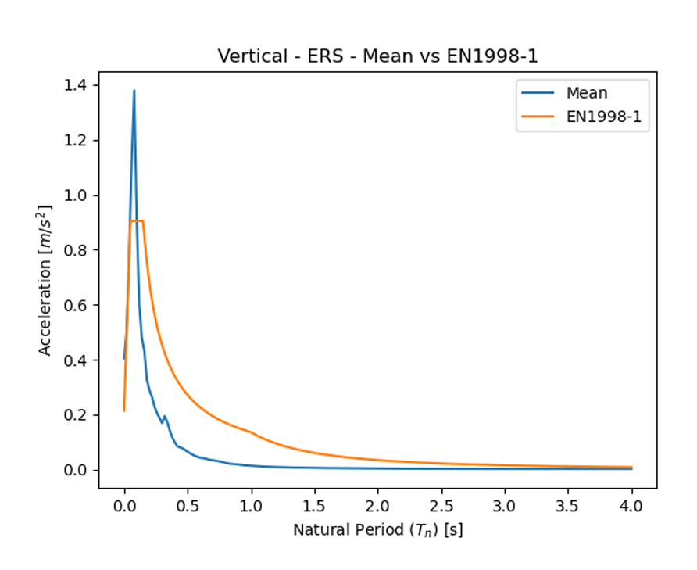
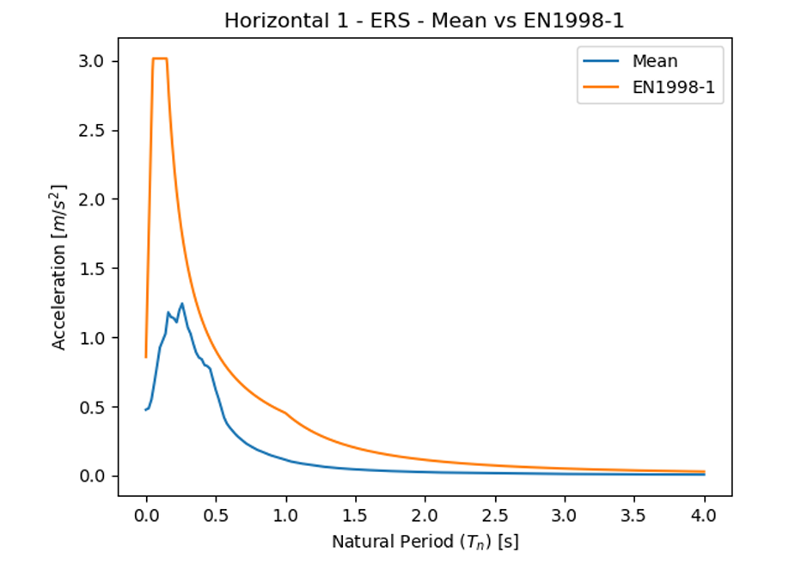
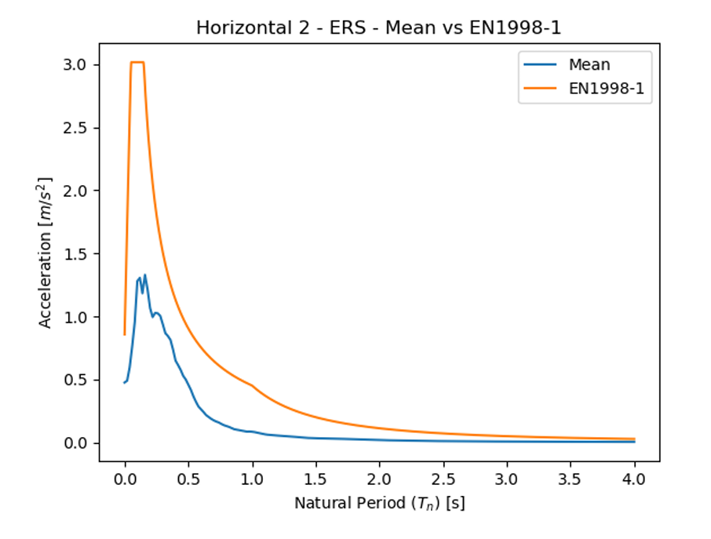
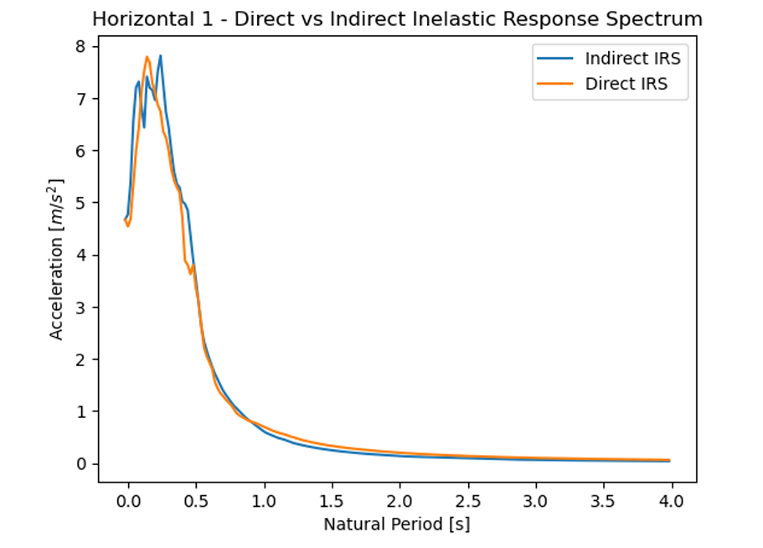
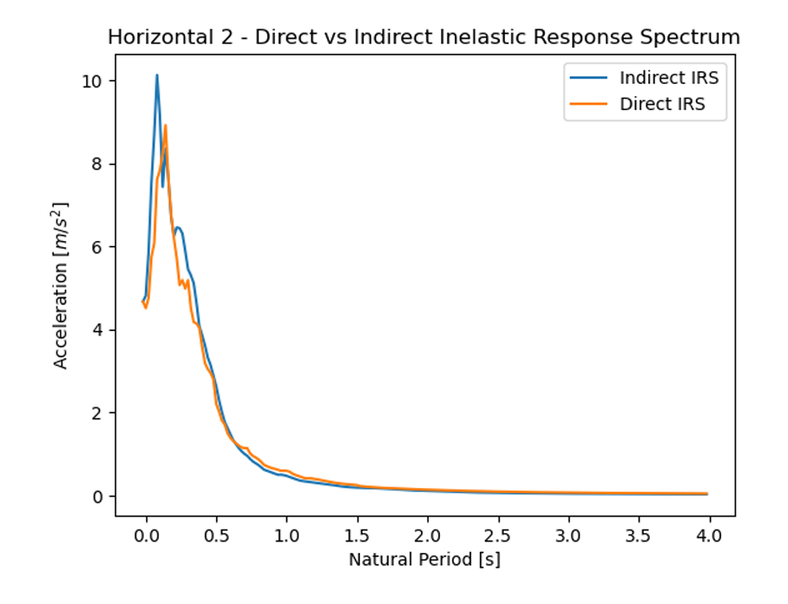
ERS and IERS

Slide 2
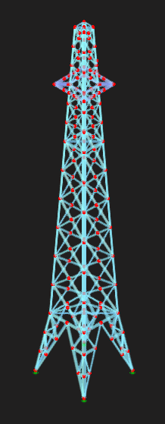
Chosen model:
Structure Type: High Voltage Power Line Truss
Materials Used: Nonlinear Steel S355 and S255

Slide 3
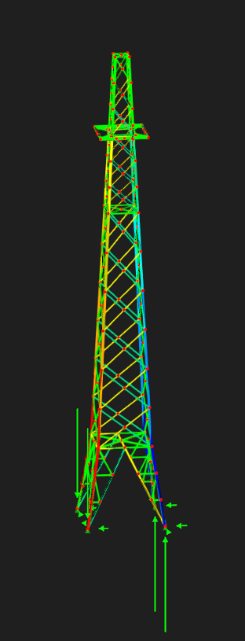
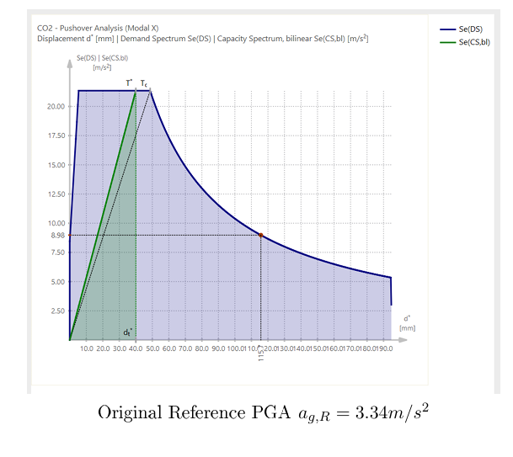
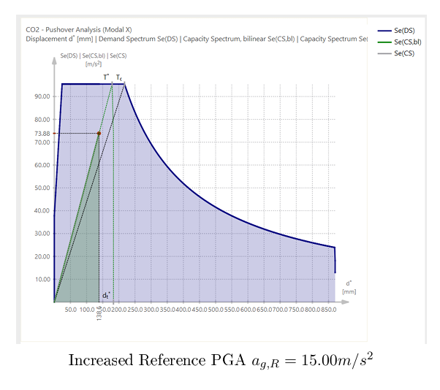
Pushover analysis
The structure withstands seismic acceleration imposed by EN1998-1 within elastic limits
Structure withstands 4.5x design PGA without yielding
No plastic deformation or structural failure observed in simulation as current model lacks detailed connection modeling
Model meets single mode approximation criteria according to EN1998-1-2005 section 4.3.3.2.1

Slide 4
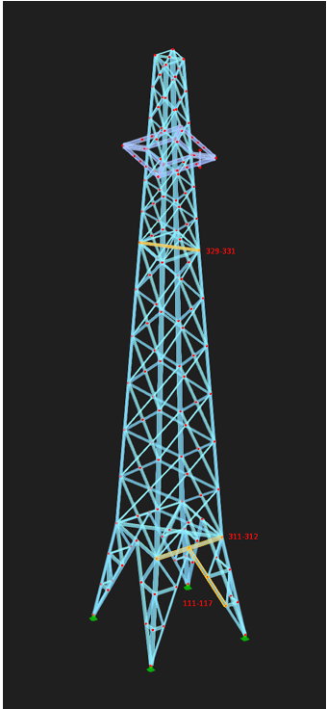
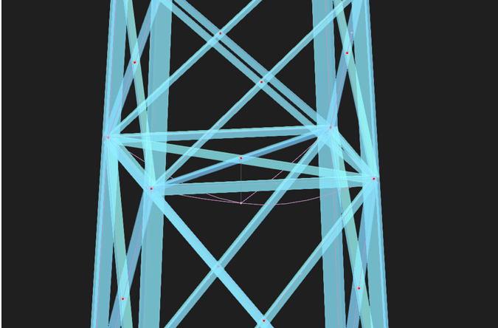
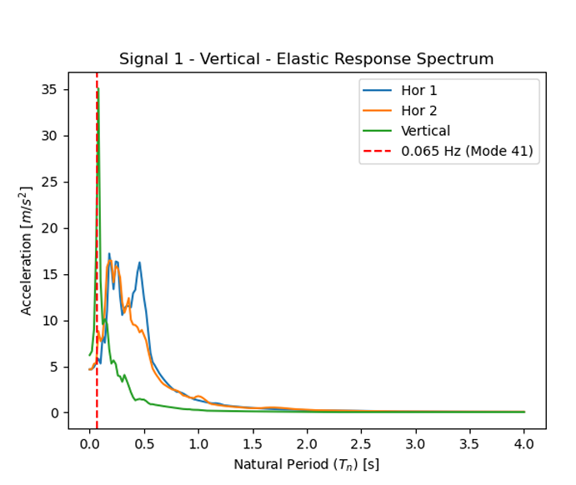
Time History Analysis
Von Mises Stress Criterion used to evaluate structural response
Compared computed stresses with Steel S355 yield strength
Critical exceedance observed at interface of Members 329–331
Mode 41 period = 0.065s, matching peak frequency of vertical seismic input .
This mode excites Members 329–331, confirming correlation with Time History results

Slide 5
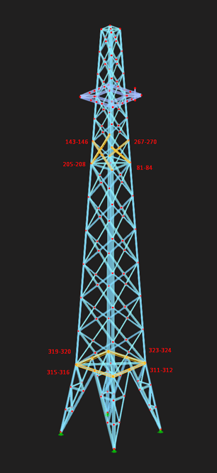
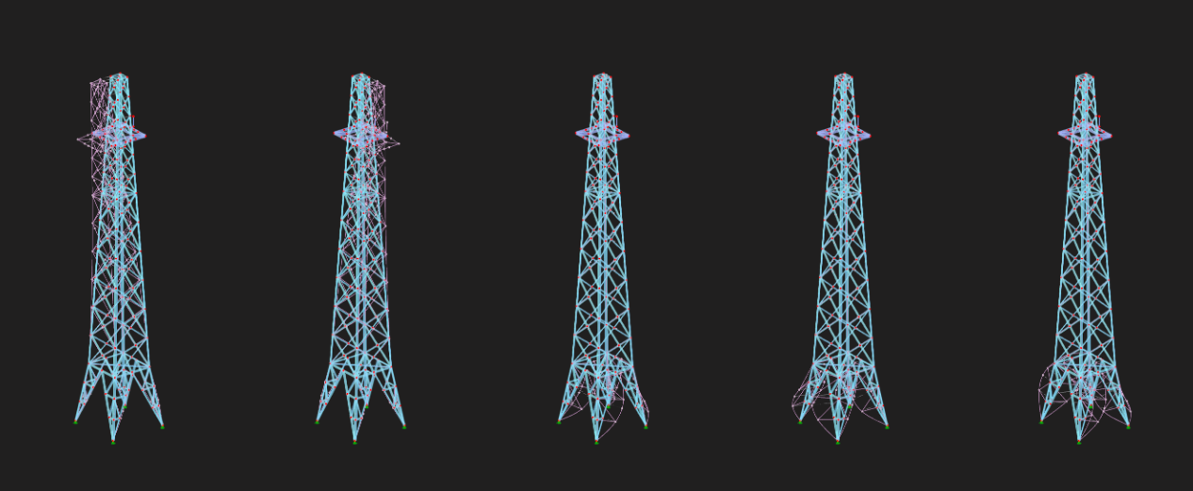
Response Spectrum Analysis
RSA results are symmetric due to identical X and Y spectra (EN1998-1) whereas THA results are asymmetric due to real accelerogram input (Signal 1)
Members 311–312 are critical in both analyses
RSA produces significantly lower stress ratios compared to THA
Indicates possible underestimation of critical effects in RSA when vertical motion is significant
The structure is able to withstand standardized seismic loads as per EN1998-1
Stress ratios remain below 1.0 (unity check) for all structural members

Slide 6
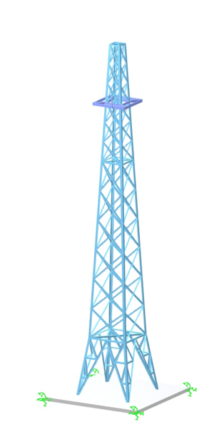
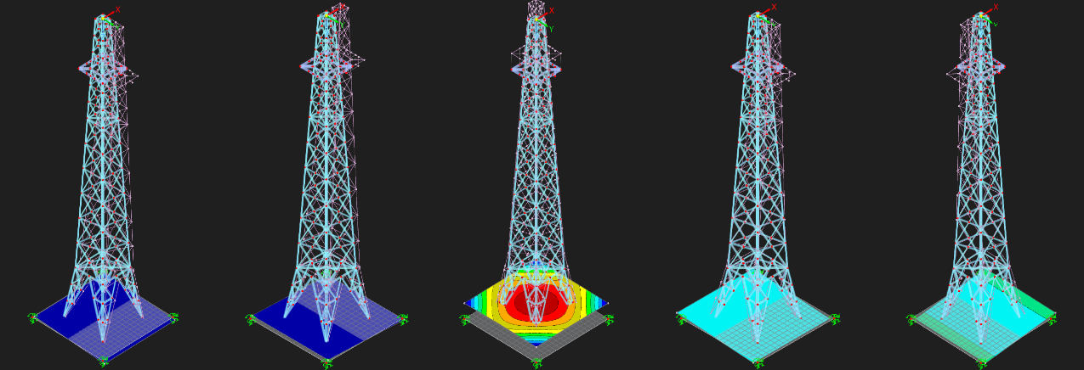
RSA with foundation
Square slab foundation was selected
Soil spring constants derived from Gazetas tables
Distributed across supports to simulate realistic load transfer and soil behavior
SSI causes period lengthening → natural frequencies shift to lower values
Higher maximum displacements observed compared to fixed-support analysis.
Displacement results reflect a more realistic seismic response

Slide 7
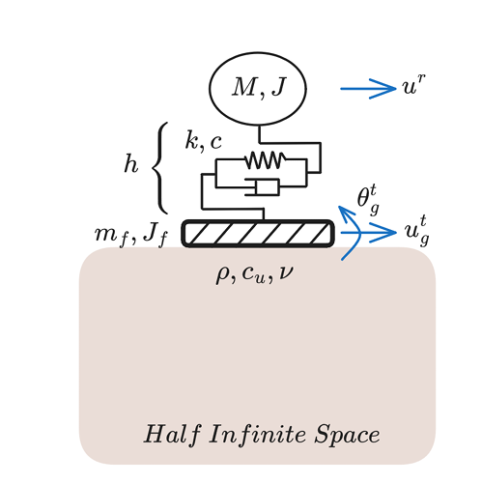
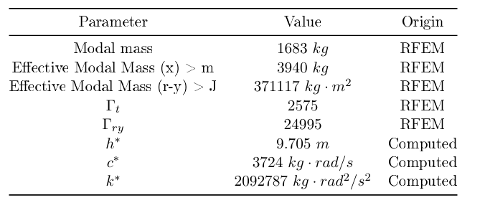
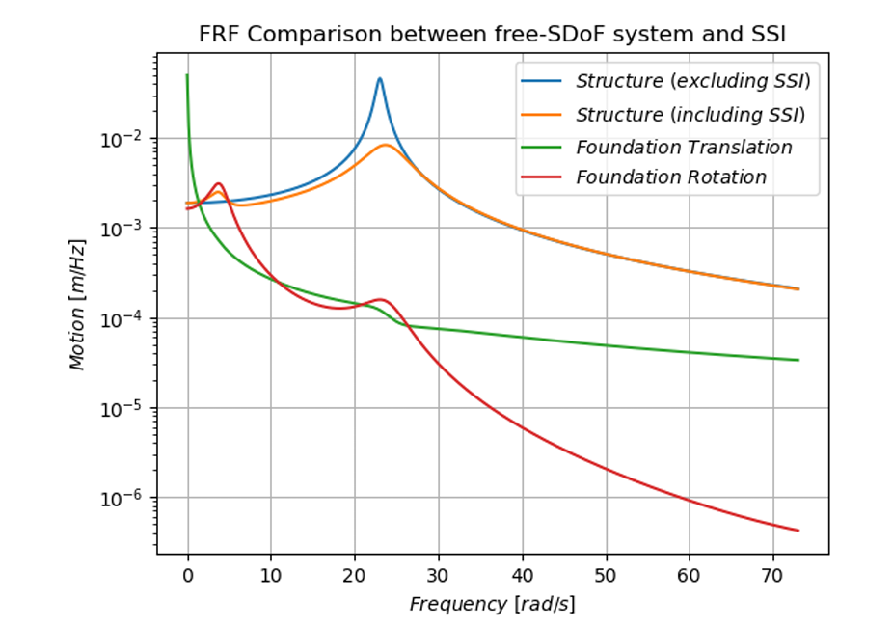
Generalised SDoF system
FRF shows a shifted and dampened peak in the top mass vibration mode with higher frequency
A second peak appears at ~3 Hz Associated with the rotational natural frequency of the foundation system

